Slide 1
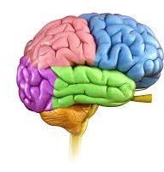
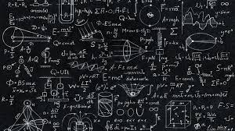

Is The Human Brain Designed To Do Maths?
What does this PowerPoint entail?

Slide 2

Introduction
Mathematics is an integral part of daily life, extending far beyond its applications in finance, loans, or monetary matters. It plays a role in activities such as cooking, analysing sports strategies, and even creating music. These are just a few examples of how maths integrates into everyday routines. The discipline equips individuals with essential skills to analyse data, recognise patterns, and devise innovative solutions to complex challenges. These abilities are introduced to children to support their problem-solving capabilities later in life.

Slide 3
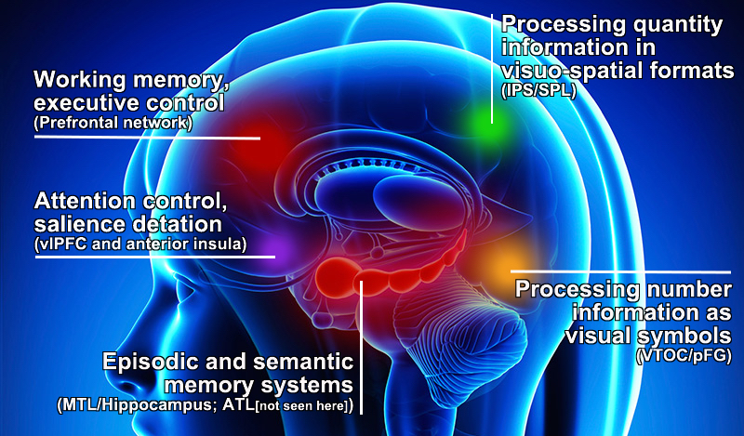
What about the brain gives us the ability to do maths?
Mathematical processing
Recognising and solving problems
Abstract and symbolic thinking
Cognitive flexibility

Slide 4
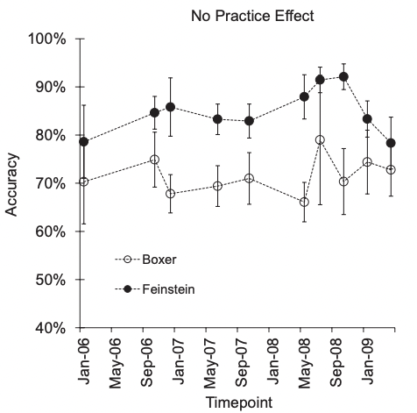
How are some people better at maths than others?
Differences in individuals' mathematical abilities often depend on their exposure to foundational concepts and the consistency with which they engage in mathematical practice throughout their lives. Regular practice and application of mathematical skills significantly impact proficiency. However, some individuals appear to have a natural aptitude for mathematics. These individuals often exhibit an innate awareness of quantitative information, grasping mathematical concepts with ease and displaying talent from an early age.
A common misconception about mathematical ability is its direct correlation with IQ. While a higher IQ can sometimes indicate mathematical aptitude, this is not universally true. Even accomplished mathematicians may have average or below-average IQ scores. Interestingly, research suggests that practicing mathematics can enhance cognitive abilities, including IQ.

Slide 5

Conclusion
Overall, there are a lot of factors that can affect how good at maths one can be however the brain does provide humans with all the necessary abilities to understand and do maths from the mathematical processing in the brain to the prefrontal cortex. Therefore, the brain is always capable of doing maths but needs practice in order to reach a high level like many other skills in life. The brain in itself may not be designed to do maths but in the world as it has evolved to be maths is a necessity that humans need and therefore the brain has used the required abilities it maintains of in order to provide the mathematical skills that all human use.

